Slide 1



Using the Madrigal Database for Atmospheric Science
1
Katherine Cariglia
MIT Haystack Observatory
cariglia@mit.edu
2024 PyHC Summer School, Boulder, CO

Slide 2
Introduction: the CEDAR Madrigal Database
2
CEDAR is a research community investigating the near-Earth space environment
CEDAR Madrigal database is a community resource for upper atmospheric science data from various ground and space-based instruments from around the world
MIT Haystack Observatory Atmospheric and Geospace Science Group maintains the CEDAR Madrigal database
Madrigal is part of Millstone Hill Geospace Facility - supported by NSF

Slide 3




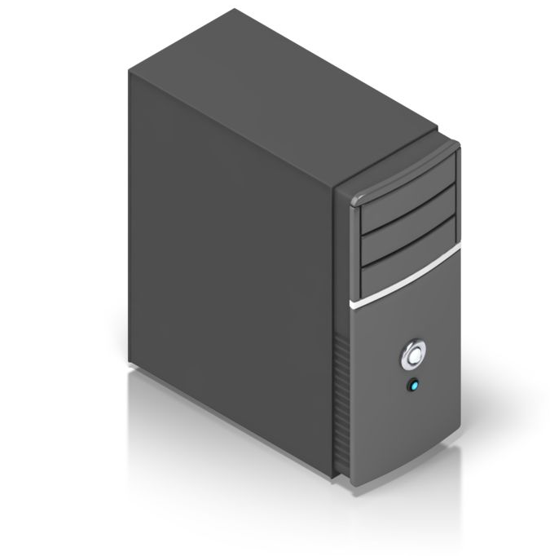



Madrigal: A Distributed Database
3
Madrigal DB
Madrigal DB
Madrigal DB
Madrigal DB
Madrigal DB
Shared metadata
Madrigal DB
Madrigal DB

Slide 4
CEDAR Madrigal Archive Imports All Data Weekly
4
Madrigal DB
Madrigal DB
Madrigal DB
Madrigal DB
Madrigal DB
Madrigal DB
Madrigal DB

Slide 5
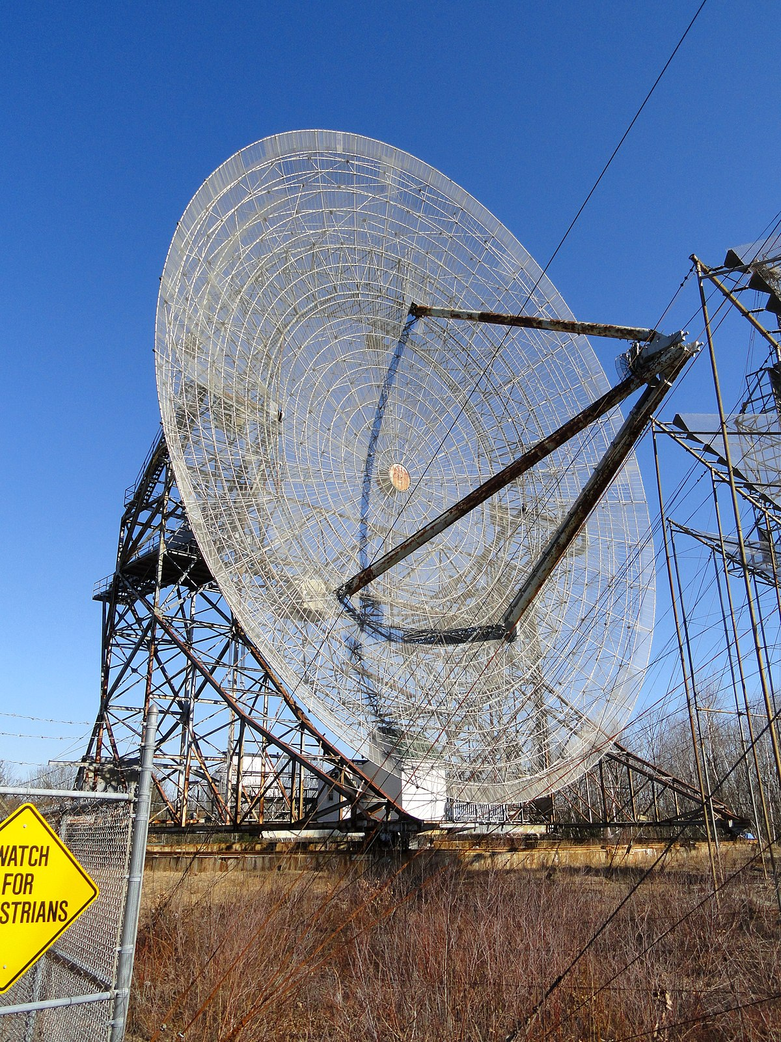
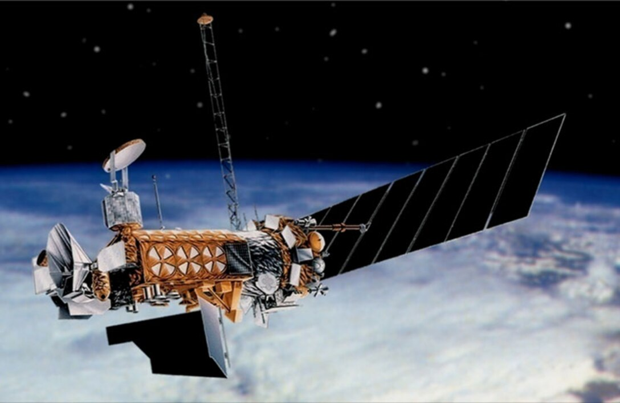
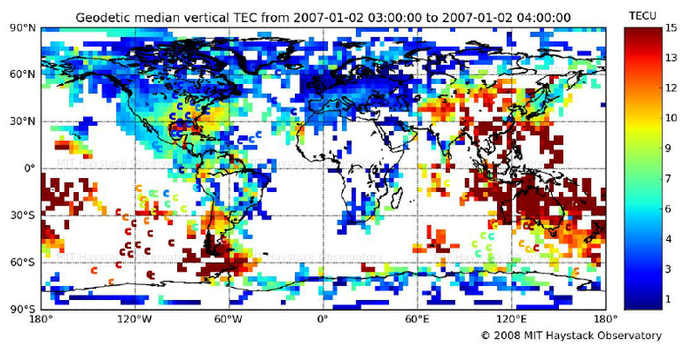
What Kind of Data is Stored in Madrigal?
5
DMSP
GNSS TEC
ISR
200 Diverse Instruments in Madrigal
Incoherent scatter radars (ISR): 28 Michelson Interferometers: 6
Lower/middle atmosphere radars: 21 Lidars: 10
Photometers: 7 Meteor radars: 18
Fabry Perot Interferometers: 38 GNSS Total Electron Content (TEC)
Defense Meteorological Satellite Program (DMSP)

Slide 6
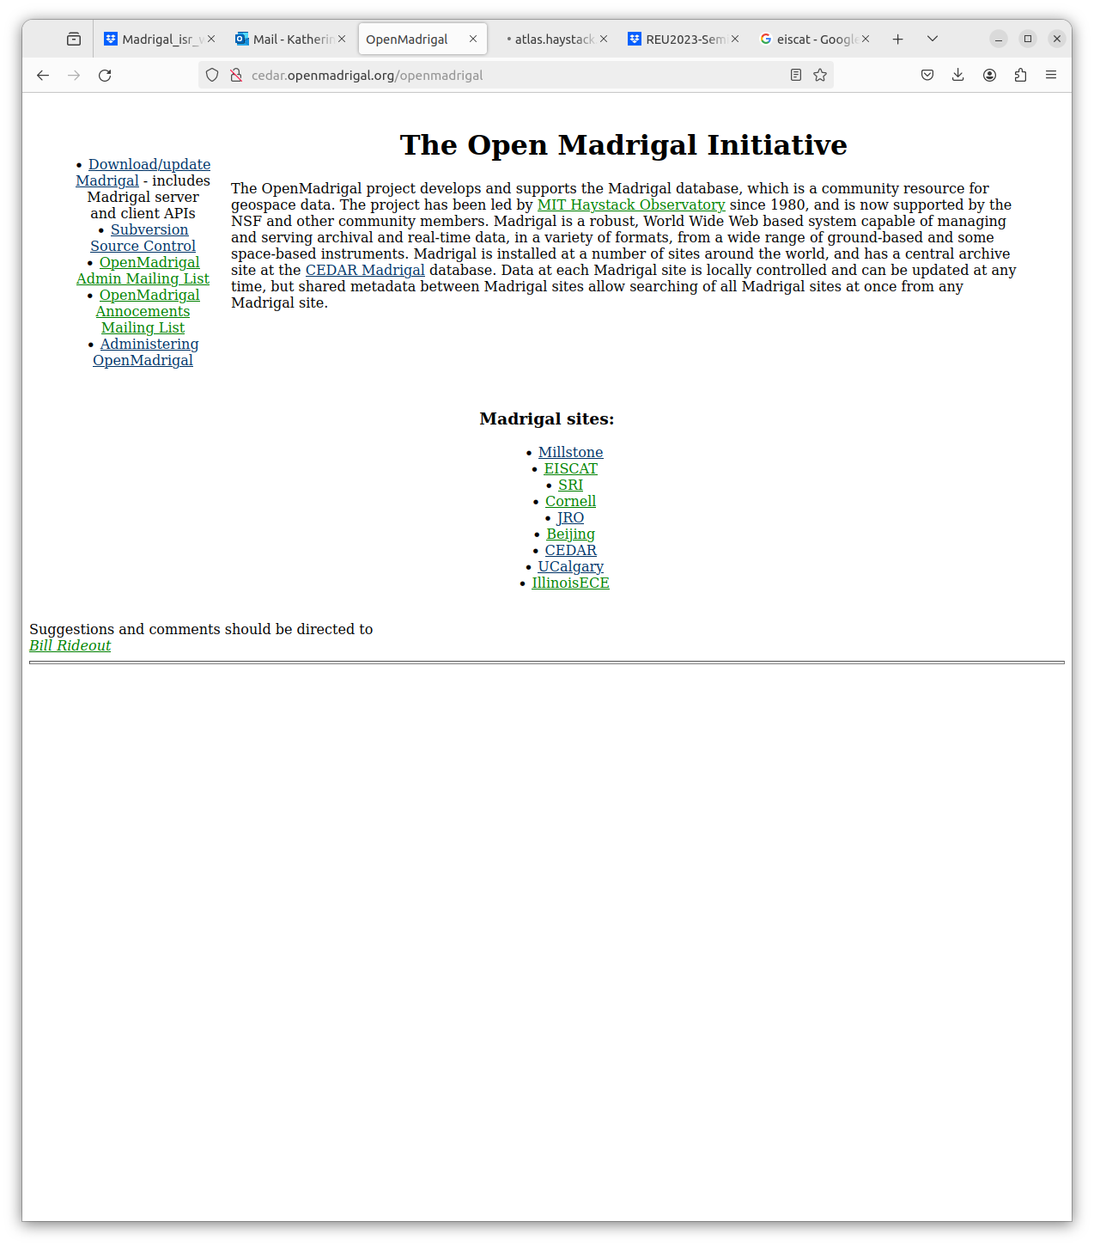
Madrigal is Open Source
6
www.openmadrigal.org

Slide 7
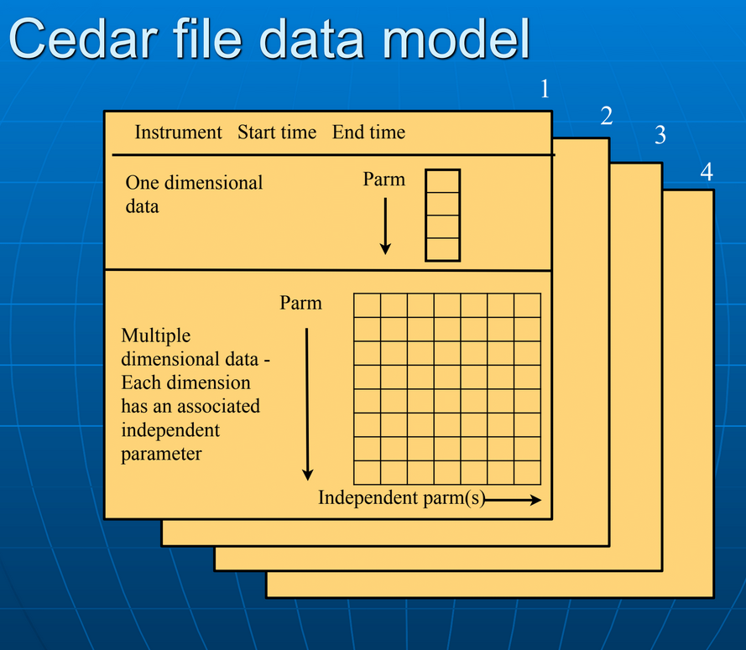
The CEDAR Madrigal Database Format
7
Underlying data format is HDF5
Well-defined parameters with standardized descriptions, units
All parameters have corresponding uncertainty parameters
Missing and assumed values included
Well-defined parameter standards allow for the existence of a derivation engine, given a geographic location and datetime

Slide 8
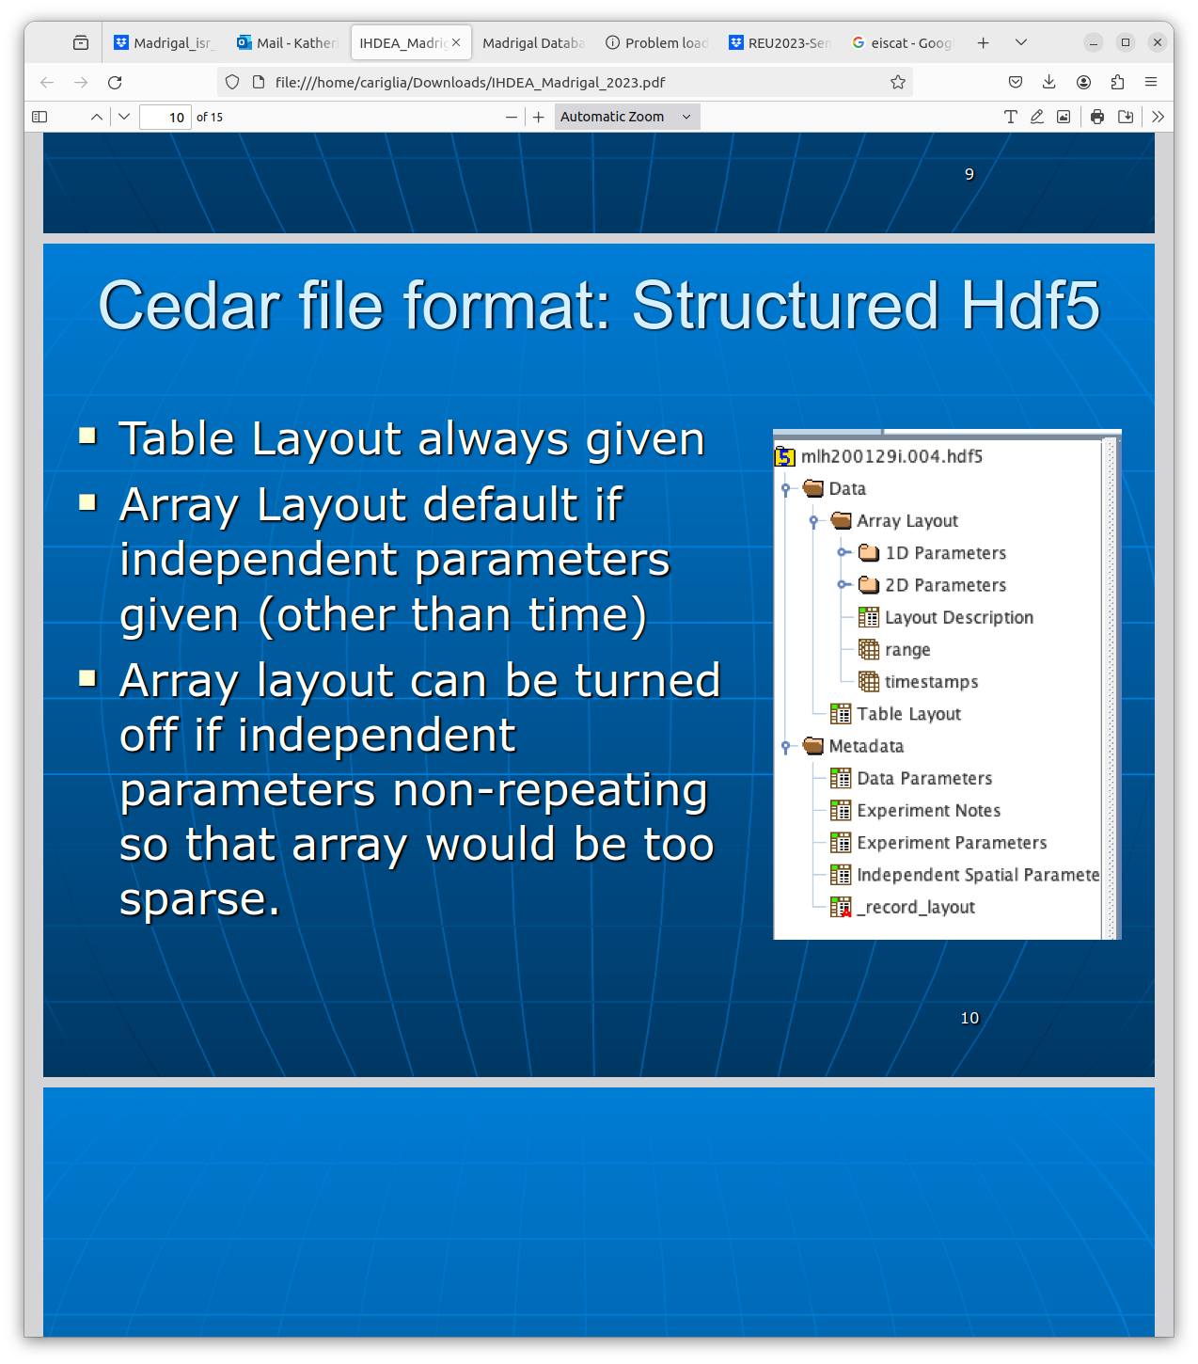
CEDAR File Format: Structured HDF5
8
Self-describing data: all parameters/units defined, notes/definitions included
Table Layout always given
Array Layout is default if independent parameters are given

Slide 9


Madrigal Metadata Model
9
Madrigal DB
Madrigal site - a facility with scientists and a Madrigal installation
Data shared among all Madrigal sites
Instruments - ground based (set location) or satellites
Experiments - limited duration, single PI contact
Experiment files - data from one analysis of the experiment
Data unique to one Madrigal site
Records - measurement over a single period of time

Slide 10
In What Formats Can Users Get Madrigal Data?
10
Underlying format: HDF5
Output formats: HDF5, netCDF4, ascii
All output formats contain both observed and derived parameters

Slide 11

Using Madrigal - Rules of the Road
11
If you wish to use Madrigal data in a paper or talk, please contact the PI
PI for every experiment listed on data download page
Grant funding
Use of data without informing the PI may lead to bad luck with grant writing-- don’t let this happen to you!
Grant funding
The PI whose data you used without permission or acknowledgement

Slide 12

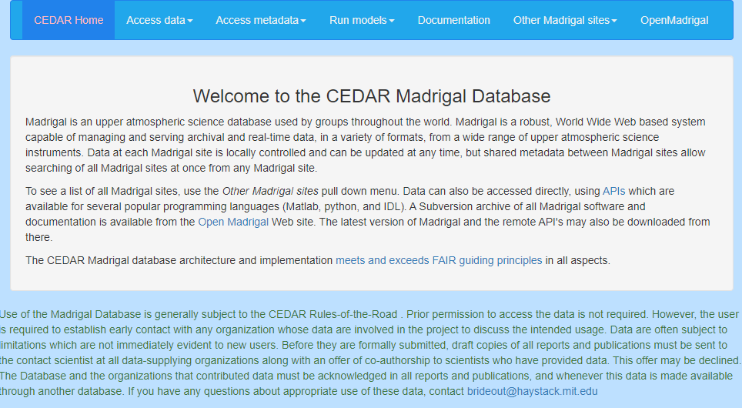
Using Madrigal - Web or API Access
12
User
Web Interface
Web Services API
Python
Matlab
IDL
Typical use case: data discovery
Create scripts using the MadrigalWeb API for all your data needs!
Faster downloads compared to web interface
Data flexibility - filter data by desired parameters/derived parameters

Slide 13
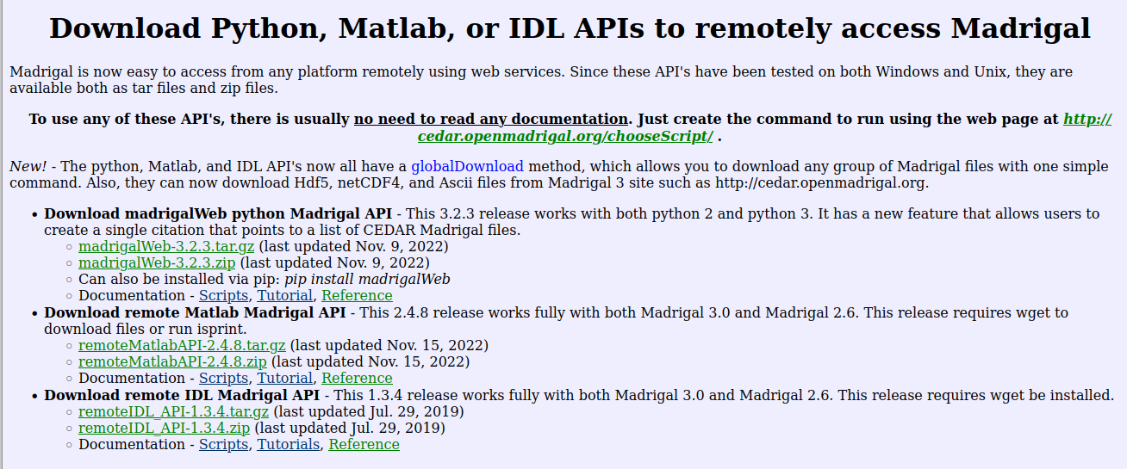
Installation of API(s)
13
MadrigalWeb available via pip, or you can download source
http://cedar.openmadrigal.org/madrigalDownload

Slide 14
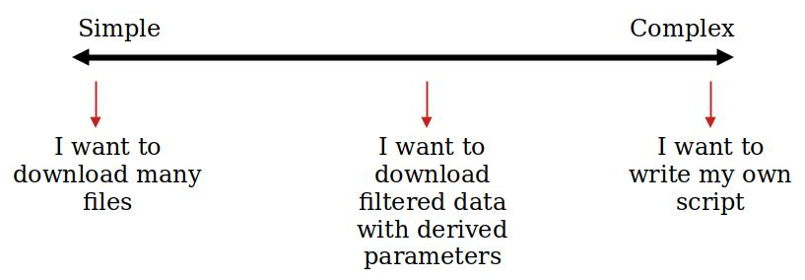
Use Cases for the API
14
globalDownload
Use APIs
Just use the web interface!
globalIsprint

Slide 15
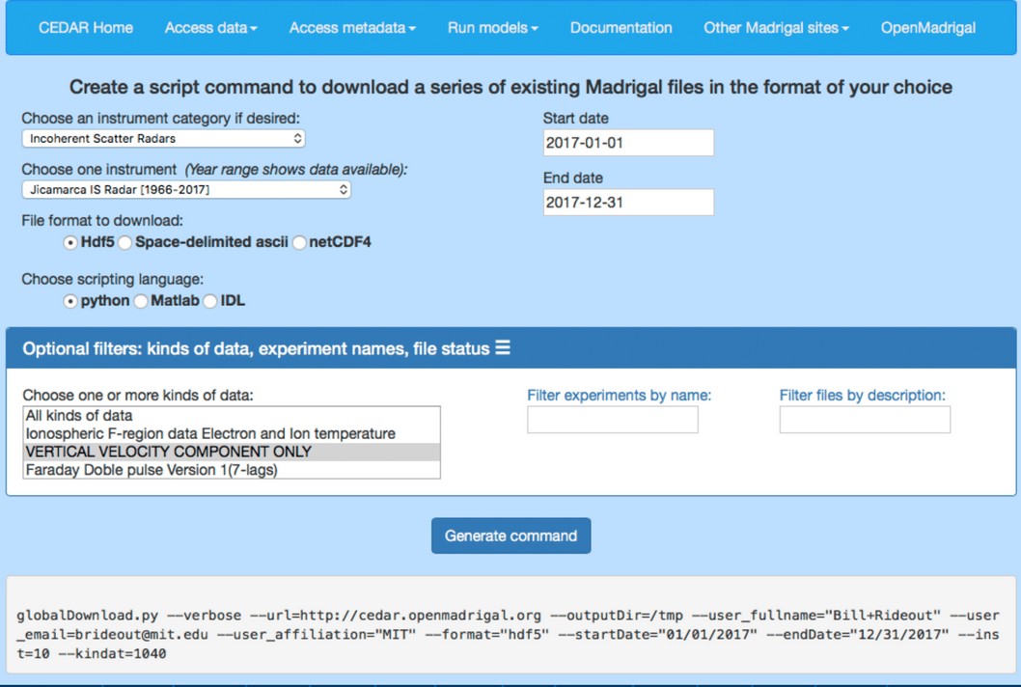
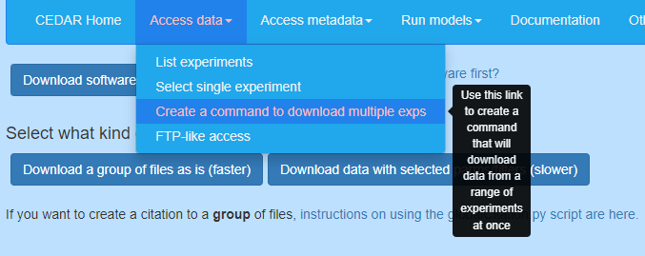
Download Scripts Generated by Web
15
No need to read documentation!
First, create a command
Next, download set of files as is or with selected parameters/filters

Slide 16
MadrigalWeb API Jupyter Notebook Example
16
The Jupyter notebook used for this exercise can be found at:
https://kcariglia.github.io/PyHC2024/pyhc_demo.ipynb

Slide 17
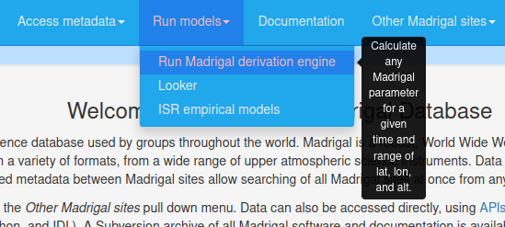
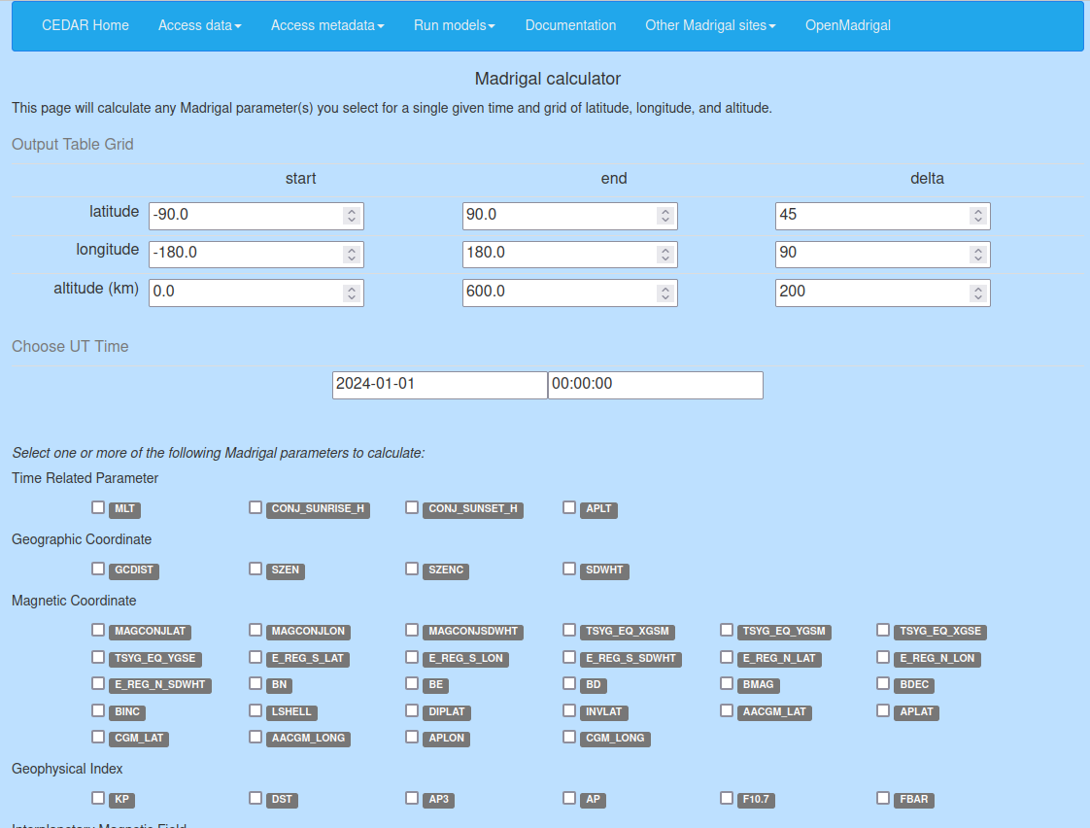
Madrigal Derivation Engine
17
Standardization of file parameters allows the existence of the derivation engine
All parameters have corresponding uncertainty parameters
Independent parameters built into standard
Derived parameters appear in file
Derivation engine determines which parameters can be derived
New derived parameters easy to implement in C or Fortran

Slide 18
Types of Derived Parameters
18
Space and time
Local time
Shadow height
Geophysical
Kp
Dst
Imf
F10.7
Magnetic
Bmag, mag conjugate lat + lon, Tsyganenko magnetic equatorial plane intercept
Models
MSIS - neutral atmosphere model
IRI - International Reference Ionosphere model
Other Models
NATEC - North American Total Electron Content model
Empirical ISR - developed at MIT Haystack

Slide 19
How to Get Your Instrument’s Data into Madrigal
19
Method 1: Send data to CEDAR Madrigal
Send data, documentation, and summary plots to MIT Haystack
Loading program written by MIT Haystack, verified by you
Add new data in batches or via automated upload
Method 2: Set up your own Madrigal site
MIT Haystack will help with installation and loading programs
You control when the data is uploaded
Automated backup to CEDAR Madrigal site

Slide 20
Future Work
20
Import Madrigal Subversion repository to Github
Unit testing for Madrigal and MadrigalWeb API
Make MadrigalWeb conform to HelioPy coding standards
Python implementation of derived parameters - move away from C and Fortran (where possible)
Include geographic bounds of experiment data in metadata, would support SPASE data model
MadrigalWeb available via Conda

Slide 21
Thank you for listening!
21
Many thanks to the organizers of this workshop for supporting early career researchers (such as myself!)
Any questions? Please contact at cariglia@mit.edu
Notes:
Questions, comments: cariglia@mit.edu
Add NSF logo and a meeting logo?

